Slide 1
C++ Classes and File Structure
IN628 Intermediate Algorithms and Architectures
Session 2.1
Semester 2, 2016
Notes:
In this practical, we introduce the .h and .cpp file structure distinction.
You will not have seen this in Java or C#
We will use camel notation.
Students should pick some naming convention they like and stick to it, but it needn’t be this one. In .NET one often sees leading caps, even in C++. The convention is that private entities start with lower case and public with upper.

Slide 2
.h and .cpp
In C++ we separate the definition of our classes from the implementation of our classes.
Definitions go in .h files
Implementations go in .cpp files
For each class, we have a pair of files
myClass.h
myClass.cpp
Notes:
We will see that VS helps us make the correct files

Slide 3
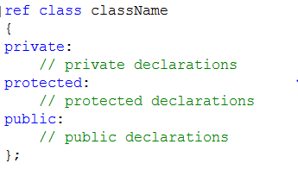
C++ Class Definition Syntax
In the .h file:
Class data member declarations
Class method function prototypes
Notes:
In the .h we declare, but do not initialise, data fields.
In the .h we give function prototypes (return type, name and arguments lists), but no code.
Schematically, the .h looks like this:
This goes in the .h
This is a non-descending class
Classes in Visual C++ are either ref or value. The default is ref.
A value class is one with no methods (i.e. a record)
Slightly more efficient implementation, can only be declared statically.
Mostly we ignore this and just make ref classes (the default)
There are three scoping options:
Private: Accessible only by class members
Protected: Accessible by class members and descendants of class
Public: Accessible by everyone
Note that all we have in the .h are declarations. The .h file (usually) contains no code (almost). All the code lives in the .cpp.

Slide 4
C++ Class Definition Syntax
In the .cpp file:
Code for all the class methods declared in the .h file.
Notes:
NB: When you add a new class to a project via the appropriate VS Wizard, it automatically generates the .h and .cpp files for you, puts them into the correct folders and adds them to the build.
This is why you should try to always create new classes this way.
It is also possible to add existing classes to a project (this is code reuse, which is good), but you have to be careful to make sure that you get everything wired up correctly. We will look at this later.

Slide 5
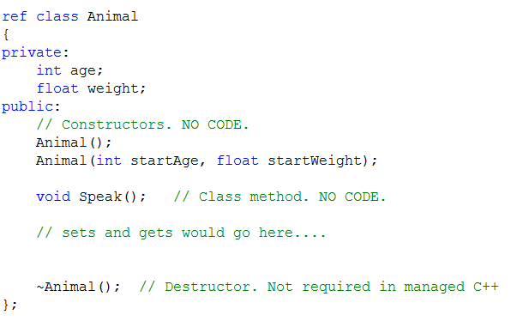
Example: Animal.h
Notes:
Notice:
Variables are not initialised at declaration.
There is no code. Only the prototypes.
The ; following the ) is how the compiler knows there is no code coming. It will look elsewhere for it. (We see where in a moment).
There are a couple of exceptions to the “no code in the .h” rule.
One of them is Form.h. That’s just weird.
Another is in the declaration of special classes called “templates”, which some of you may decide to use later in the semester, but this is optional
The third (online expansion) we will see in a bit
Constructors: No return type and the same name as the class.
We have two overloaded constructors here. You can have as many instances of the same function name as you want, as long as the argument lists are different.
Note that in C++ it is conventional to name input arguments something different from the variable to which they will be assigned. (This is a change from Java where you give them the same names and use “this” to differentiate in the code.)
Normal class method prototypes. No code here.
To begin, we will write regular sets and gets for our classes. Visual C++ (not native C++) provides a short-hand alternative we will introduce later.
Destructors are methods that are executed when the memory for an object instance is released. In managed languages with automatic garbage collection, we generally don’t have to write destructors. There are some advanced situations where you do – where you want to perform particular clean-up tasks when a object is deleted from memory. This can be closing files or database connections, or manually deleting dynamically generated properties of the class. If you want to do stuff like that, write a destructor.

Slide 6
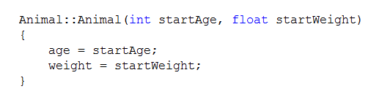
Example Animal.cpp
Notes:
In the .cpp you provide code for every method declared in the .h
Recall that we have two constructors and the class method Speak. (We won’t make a destructor.)
So in the .cpp, we will write code for those three methods.
First, let’s write the constructor that has arguments....
Note:
The function header in the .cpp must be exactly the same as the one in the .h except
You prefix the function with the class name and scoping operator ::
This is how the compiler matches up the code in .cpp files with the declarations in .h files. This is how it knows “when class X calls its method, which code should be executed”.
If you omit the class identifier, the code will not compile because it won’t be able to match up the .h and .cpp methods.
startAge and startWeight are, we can see, the function arguments. What are age and weight? => Class fields (or members, or data properties, whatever you like to call them).
Why don’t we have to declare them in this method? => They are declared in the .h file, where the class is defined. Class data members are in scope for all class methods. Any Animal:: method that refers to age is referring to the same variable => that class instance’s version of int age.
Note that in the constructor, all class data members are initialised. This is what constructors are for. When a constructor is called (via gcnew), the system allocated memory for the instance and then runs its constructor code. When that’s done, all data members must contain sensible values. Without exception. Sometimes the “sensible value” is null or empty or 0 or some other default, but you must put something in every variable. Leave no rogues around.
So what code do we put in the other constructor? The one with no arguments passed in?....

Slide 7
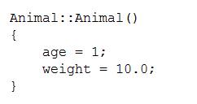
Example Animal.cpp
Notes:
When no data values are passed in, we have to come up with sensible defaults on our own.
Often, these are logical defined by the application. For example, you might create game characters who start with 100% health. So that’s the default you would use.
Sometimes the default is empty. For example, you might start your game character’s experience points at 0.
In this example (class Animal, remember?) we’re not really building an application, so we’ll just choose some values for the sake of demonstration.
Here it is.
Note the class identifier Animal::
With this code, when you gcnew Animal() you get an instance with 1 and 10.0 in its instance data.

Slide 8
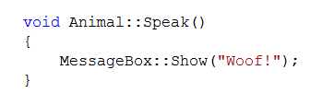
Example Animal.cpp
Notes:
The procedure for regular (non-constructor) class methods is the same. Header in the .h and code in the .cpp
As always, you must mark the method in the .cpp with the class name and scoping operator ::
Be careful, though, about where you put it. The identifier touches the method name.
For methods with a return type (i.e. all except ctor and dtor) that means the identifier goes in between the return type and the method name.
Like this...
Be aware that as your return types become more complex (e.g. When you return a pointer to an array of pointers) this starts to look pretty weird. Just attached the :: directly to the method name and you’ll be right.
One comment about this code: If you type this and try to run it, it will fail. The error will say it doesn’t recognise MessageBox.
MessageBox (and Button, and Math and String and lots of other stuff) are in their own system “namespace” (basically a group of classes and methods).
In C#, everyone can see all the system namespaces automatically. In C++, you have to explicitly list any namespaces you want to use.
You put these in the .h
Which namespaces it needs are part of a class’s definition.
So our complete .h looks like this...

Slide 9
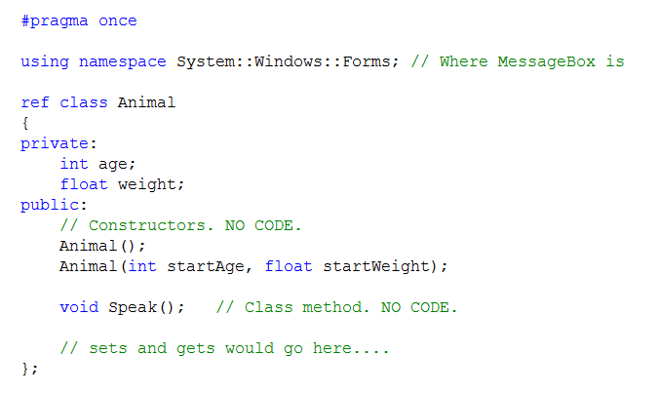
Animal.h
Notes:
The complete .h
Arrows:
#pragma once is automatically supplied by the system. That’s the first line of every .h file you get. It tells the compiler to only add this class once to the build. In native C++, this is #ifndef and a couple of other lines. That’s what you’ll see in the wild. They do the same job.
We put this in ourselves. Add a using statement for any namespace you need. One easy way is to just copy the ones from Form.h and paste them in. It doesn’t hurt to have extras, but it’s a pain when you miss one out. Most commonly forgotten are System (where String is) and Drawing (where the Graphics class is).
This semi-colon is part of the code supplied by the system when you create a class. It follows the closing curly bracket of the class definition code block, which starts with ref class Animal. BE CAREFUL WITH IT. NEVER DELETE IT. If you inadvertently delete the closing semi-colon from a class you will get the weirdest compile errors ever, as the compiler will just keep adding random code to this class until things explode. If you ever get a really absurd compile error somewhere in the main method or other code that you have never touched, check all your class declarations for missing closing semi-colons.
And our complete .cpp file is:

Slide 10
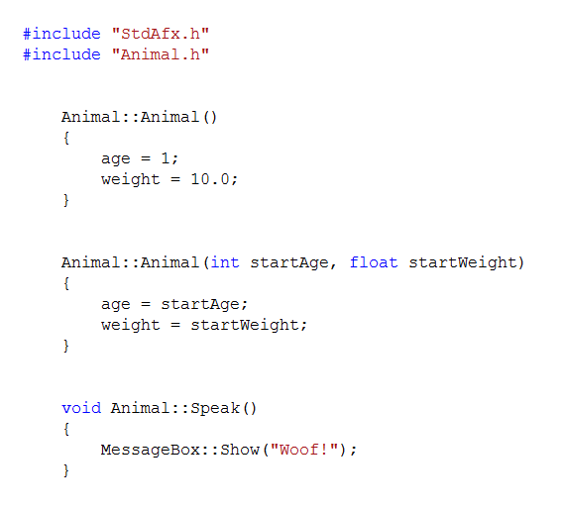
Animal.cpp
Notes:
Arrow: Note the #include. These statements are inserted by the system when it creates your empty .h and .cpp files.
These, and all the # statements are “compiler directives” (The #pragma once is another.)
The #include says “Go get this file and copy and paste it in here before you try to compile me.”
If you forget this line in a .cpp, the compiler can’t match up the .h and the .cpp files.
Also, if you want one class to be able to create instances of another class, you must include the consumed .h in the consumer’s .h. Otherwise it will go “that’s not a type!”
Note that you only ever include .h files, never .cpp. Why do you think that is? => Because the .h contains all the information the compiler needs. It contains the definition of the class. The class’s interface.
This is a very OO thing. The “.h and .cpp” structure is a direct map to the OO distinction between interface and implementation. You may have heard this called “information hiding”. The .h tells you everything you need to know to use the class; implementation details are hidden in the .cpp.
This is one of the reasons C++ is a more pure OO language than C#.

Slide 11
Sets and Gets
Notes:
We’ve been putting off the sets and gets.
The reason is that they are handled a little differently in colloquial C++
Not because they are sets and gets, but because they are one line methods
An exception to the “no code” rule is made when the method contains exactly one line of code.
When that happens, you can write the code directly in the .h, following a special format that we will see in a minute.
This is called in-line expansion
It looks like this....

Slide 12
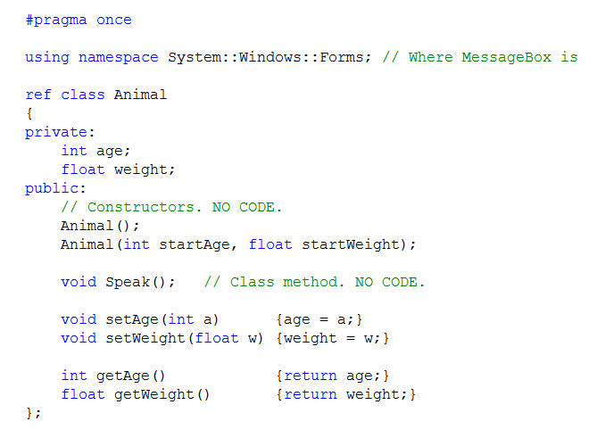
Implementing One Line Methods
In Animal.h
Notes:
Note that if you have more complex set/get, if, for example you do error checking before setting, the method will be more than one line long, and you must define it in the .cpp.
Note also, that you are not required to do one line methods this way. For example, Speak() was one line, but we did it the separate way. Traditionally, inline expansion will be reserved for accessors and modifiers

Slide 13
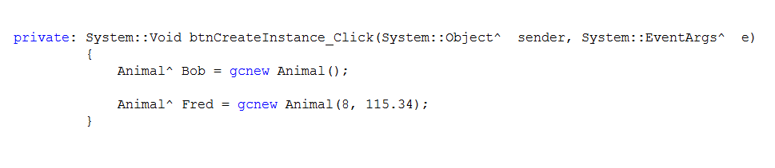
Creating Class Instances
Notes:
So now you have a class (yay!).
How do you get an instance of the class?
In some method that can see Animal.h (because you’ve got a #include for it), you do this...
This code is in the click handler for a button on my form.
What is Bob’s age? And his weight? (1 and 10.0; as specified in the code for the default ctor).

Slide 14
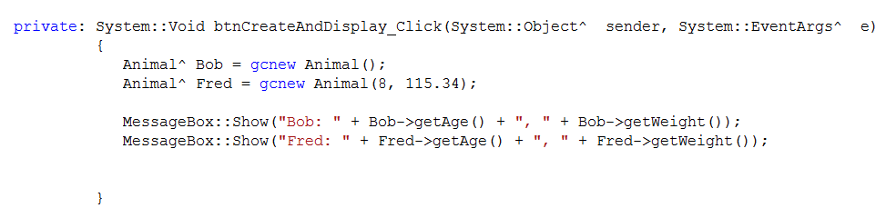
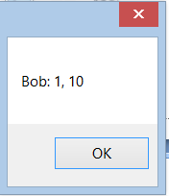
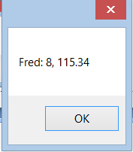
Using Class Instances
Notes:
And to use them....
What is the output?

Slide 15
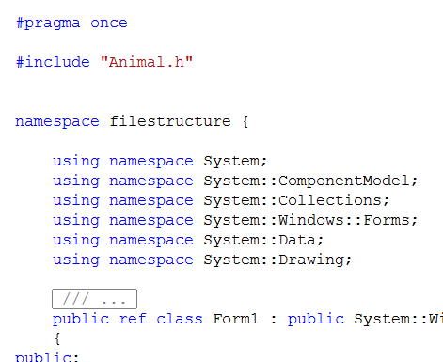
Remember #include
Notes:
This is the top of Form1.h. I added the #include so that I could declare an Animal^.
That is, so that the Form could see data type (class type) Animal.
Note the quotes. This is a filename (so a string) not an object.
(Those, by the way, are the namespace statements I copy and paste into every .h file....)
What would happen if I had forgotten that include?

Slide 16
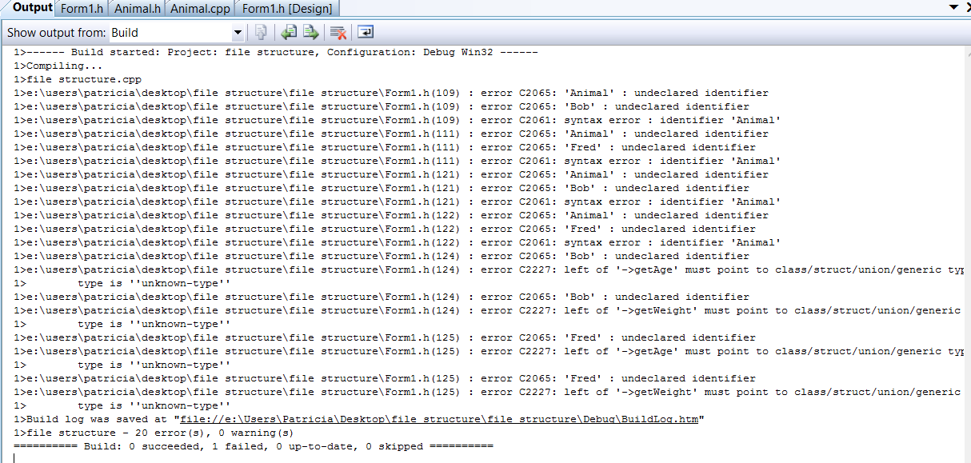
Remember #include
Notes:
This happens.
The trouble all starts with “Animal : undeclared identifier”
The compiler doesn’t recognise Animal as a class, so it can’t be a data type, so you can’t declare pointers to instances of it, so everything breaks.
When you know you have built a perfectly good class, but the compiler doesn’t recognise it, you are almost certainly missing an include.

Slide 17


A .NET alternative to sets and gets
If class data members are private, and you write set and get methods...
Notes:
NB: The following is only for C++/CLI, not native C++
Access and modify like this.
But this isn’t very .NET-ish.
Think about how we modify buttons...
This is cleaner (think about how you’d increment Left with sets and gets) so we like it.
Why no sets and gets?
Because in the button class, the value left has been declared as a .NET property.
When working in .NET, the word “property” has a special meaning.

Slide 18
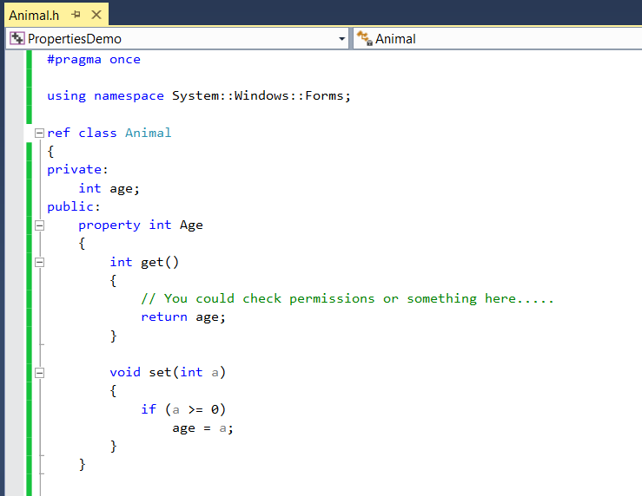
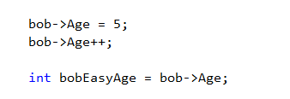
.NET property
A public-facing version of a private data member.
Notes:
Many system object data members are done this way, and you can use this approach in your own classes as well.
Here is the syntax...
First the private member, with lower case first letter.
Then the public member with upper case, marked as property
Then a code block {} containing a method get() and a method set(), containing whatever code you need.
Note that this is all in the .h file.
Now, a programmer working with an instance of Animal, can just say...
Much easier.

Slide 19
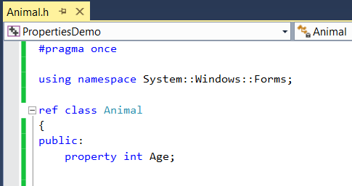
Even less typing...
Notes:
If you don’t want to put any code into the set and get methods, it’s even shorter.
You don’t even have to declare the private version at all.
Just do this...
The compiler will automatically make the private version (age) for you, and you can, with some complexity, access it if you need it (this is relevant when dealing with compiled modules, and is out of scope for this paper).
If you later want to go back and add more complexity (like checking that age >= 0) you can add that code using the previous pattern, and nothing will break.
The user says bob->Age.

Slide 20
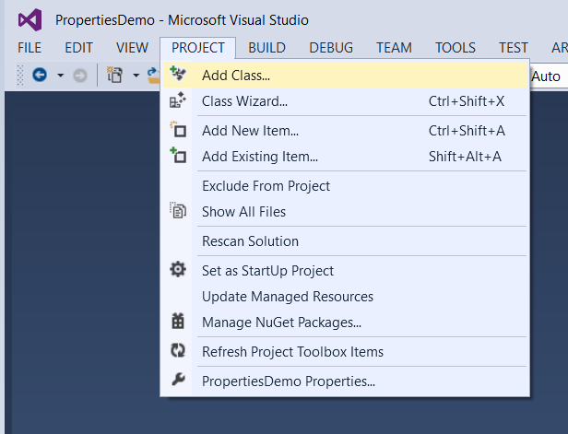
Creating a new class
Notes:
Always add your new classes this way.
It allows VS to keep track of what is in your project, so that you don’t have to worry about synchronising and building.

Slide 21
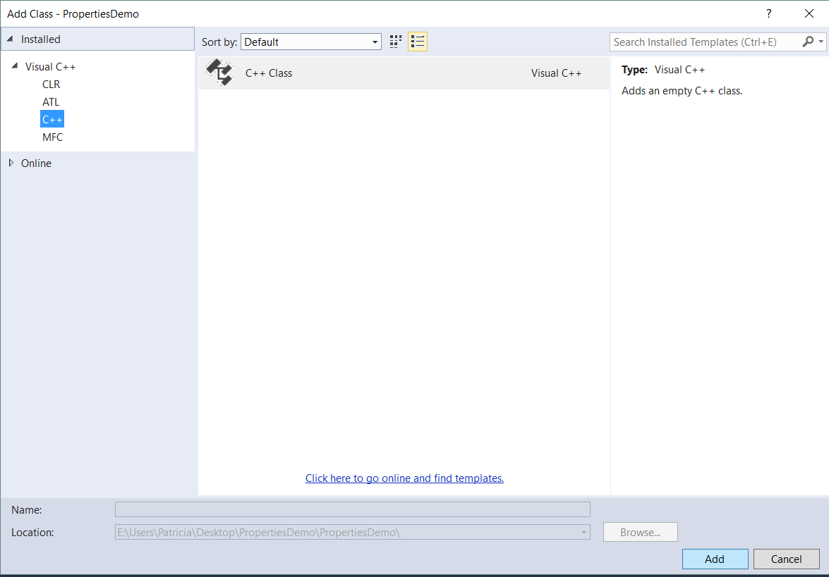
Creating a new class

Slide 22
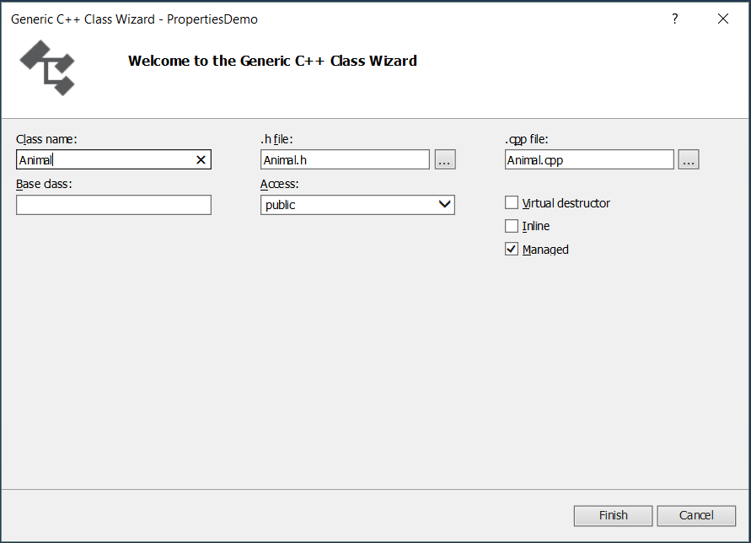
Creating a new class in VS2013
Notes:
You enter the class name (sorry about the cursor line there), VS fills in the other fields automatically
We will make managed classes
Remember, all this means is ^ and gcnew
Later, when we start inheriting, you can specify the base class here...

Slide 23
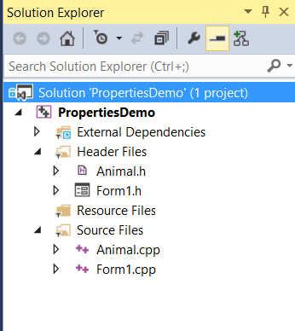
Creating a new class in VS2013
Notes:
Notice that your project now contains two new files – Animal.h and Animal.cpp
Double click on them to open them in the code editor and start adding what goes where, as we’ve discussed.
VS keeps track of all these different files when it builds and compiles. You just put everything where it goes.
So...

Slide 24
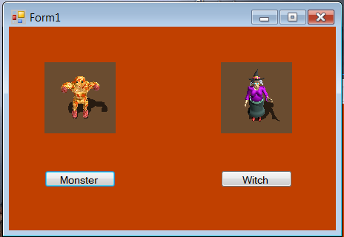
Today’s Exercise
Notes:
Classes Monster and Witch
See handout

